Slide 1


Neurasmus 2025
What is information?
Nicolas Doyon

Slide 2

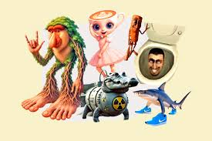
Information?
We all talk about information.
The function of the brain is to process and transform information.
But what is it exactly and how to quantify it?
Is there a difference between noise and information?

Slide 3
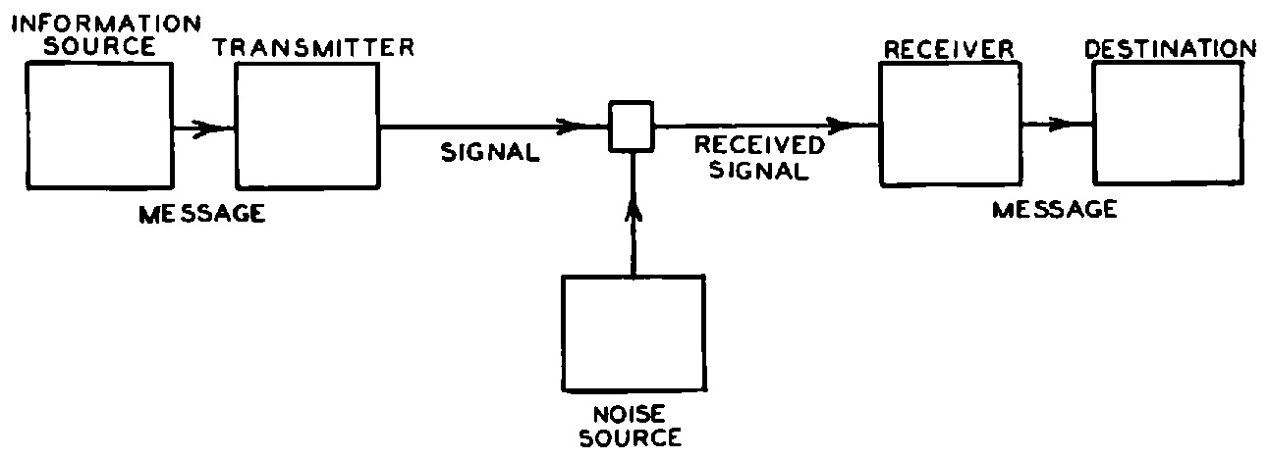
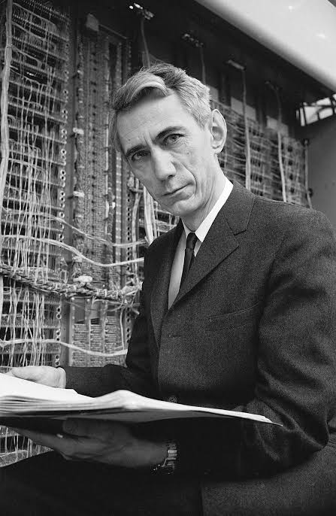
Claude Shannon
Claude E. Shannon, A Mathematical Theory of Communication, Bell System Technical Journal, vol. 27, p. 379-423 et 623-656 1948

Slide 4
How to define (quantify) information?
One can count the number of letters in a message,
The number of digits of a number,
We want an universal definition, that is independant of the encoding.
Count the minimal length of a binary chain necessery to encode information.
Or from another point of view, what is the number of yes no questions necessary to determine the answer?

Slide 5
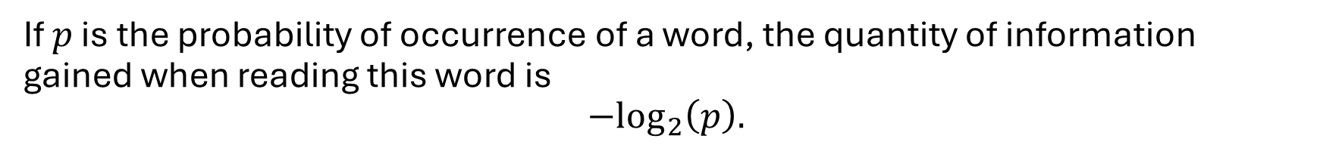
Not all information is created equal
Berlin is the capital of ____.
(Germany)
The word Germany contains no new information is it is expected from the context.
An another point of view is that the information contained in a word is related to the surprise of this word.
If $p$ is the probability of occurrence of a word, the quantity of information gained when reading this word is
$$−\log_{2}\left(p\right).$$

Slide 6
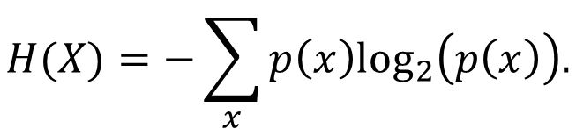
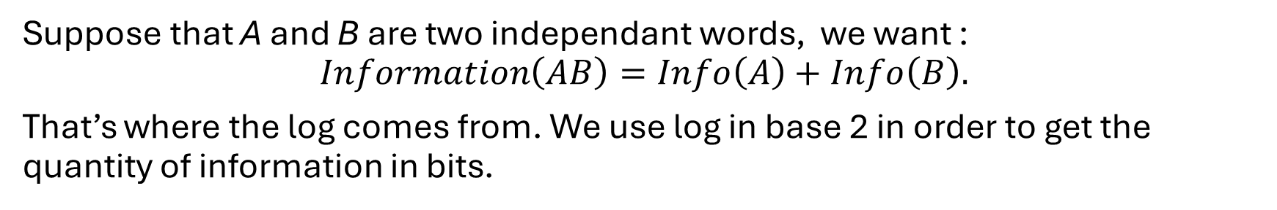
Why log₂?
Suppose that A and B are two independant words, we want :
$$Information\left(AB\right)=Info\left(A\right)+Info\left(B\right).$$
That’s where the log comes from. We use log in base 2 in order to get the quantity of information in bits.
Only surprises
Thus to maximize information, can we only use surprising words?
The entropy of a distribution X is the expected information
$$H(X)=−\sum_{x}{p\left(x\right)\log_{2}\left(p\left(x\right)\right).}$$

Slide 7
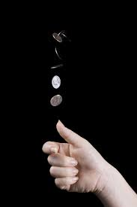
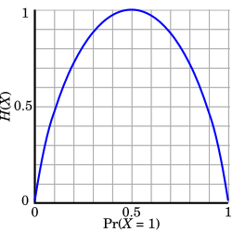
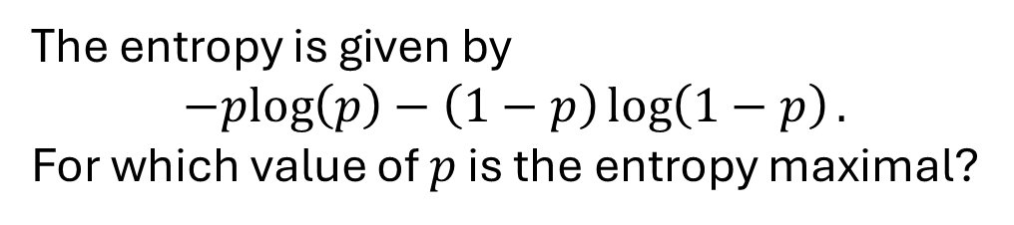
A simple example of entropy maximization
You throw a coin, you get head with a probability p and tail with a probability 1-p.
The entropy is given by
$$−plog\left(p\right)−\left(1−p\right)\log\left(1−p\right).$$
For which value of $p$ is the entropy maximal?
We could take a derivative and optimize
(but its one half)

Slide 8
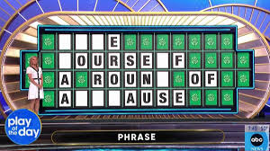
Information gain
Each letter gives you information.
Intuitively, we try to maximize the the gain of information.

Slide 9
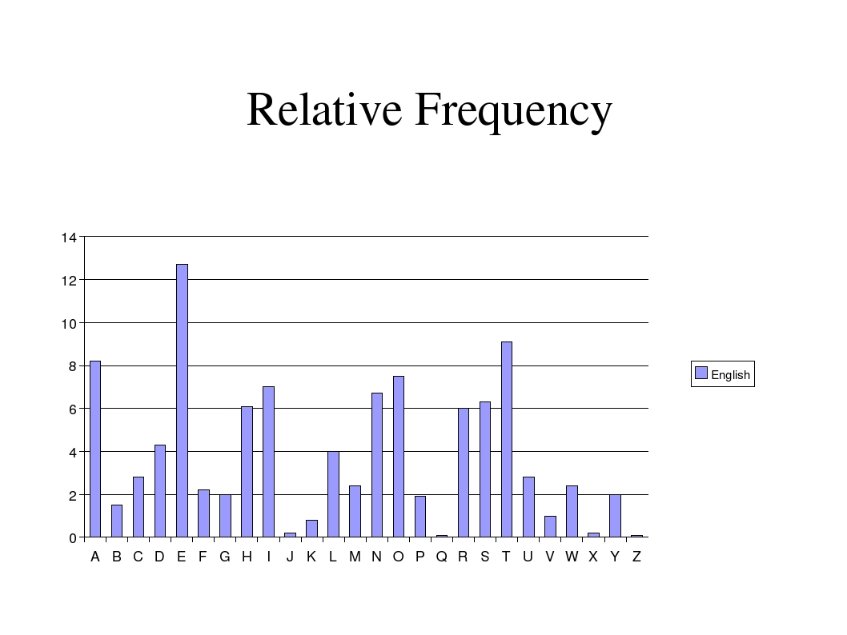
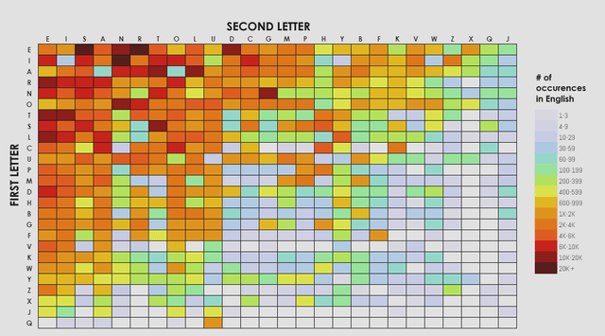
Information gain
Knowing a letter gives you information on what the next one will be

Slide 10
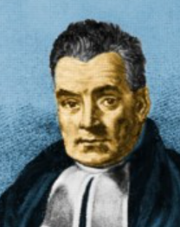
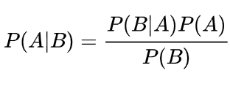
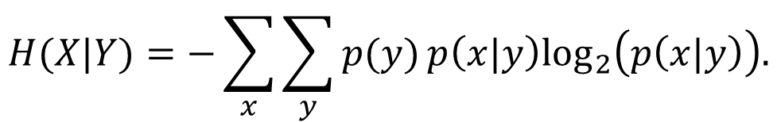
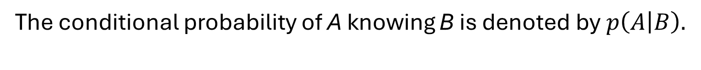
Information gain
We now provide a formal mathematical definition of information gain
The conditional probability of A knowing B is denoted by$p\left(A | B\right).$
We have the well known Bayes formula
The conditional entropy is given by
$$H(X|Y)=−\sum_{x}{\sum_{y}{p(y)}p\left(x|y\right)\log_{2}\left(p\left(x|y\right)\right).}$$

Slide 11
Information gain
From this, we can compute the information gain or mutual information
$$I\left(X,Y\right)=H\left(X\right)−H\left(X | Y\right).$$
Mutual information is always non negative
Mutual information is symmetrical
If X and Y are independant the mutual information I(X,Y) is equal to…
If X and Y are equal then I(X,Y) is equal to…

Slide 12
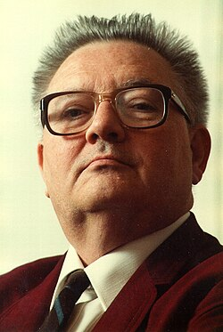
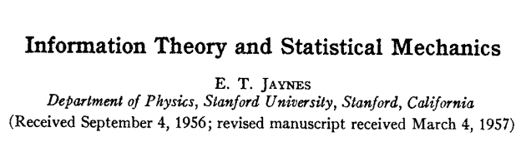
Entropy maximizing distributions
Which probability distribution maximizes entropy?
This is an important question…
In nature, distributions often tend to maximize entropy
Choosing entropy maximizing information is a way to avoid injecting bias

Slide 13

Entropy maximizing distributions
In the simple case where the variable can only take two values, we maximize entropy when the probability to take each value is one half.
Suppose that a variable can take a large but finite number of states, what distribution would maximize entropy?
The answer is when each state occurs with an equal probability.
What is the entropy of a dice roll?
$$6\log_{2}\left(6\right)≈2.58$$

Slide 14
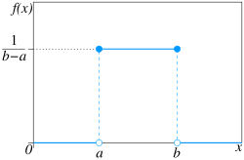
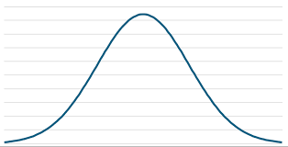
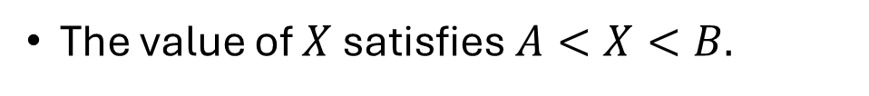
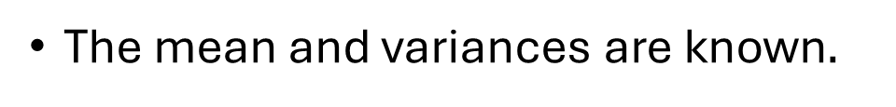
Entropy maximizing continuous distributions
This is more difficult when we consider continuous distributions.
We can consider different types of constraints
The value of $X$satisfies $A<X<B.$
We get a uniform distribution
The mean and variances are known$.$
We get a normal distribution

Slide 15
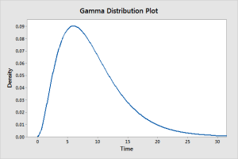
Entropy maximizing continuous distributions
The mean and variances are known and the variable is positive .
We get a Gamma distribution
Can we go a step further and do the same for families of random graphs?
Yes (kind of…)

Slide 16
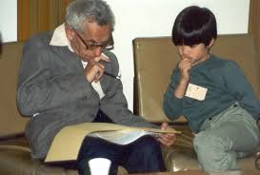
Entropy maximizing distributions for graphs
If we impose the number of edges and nodes in a graph, the entropy maximizing distribution is given by the Erdós-Renyi random model.
One can impose a hard version of the constraints in which the number of edges is always exactly the specified one.
More often, we impose a soft version of the constraints in which the expected number of edges is equal to the specified one.

Slide 17

The quantity information contained in a signal
We defined the entropy or the information contained in a discrete distribution.
When the number of possible states goes to infinity, then the information contained in the signal tends to infinity.
It’s noise….
According to Shannon, the maximal capacity ( C ) of a noisy transmission channel is
where S is the signal strength, N the noise level and B the rate of transmission.

Slide 18
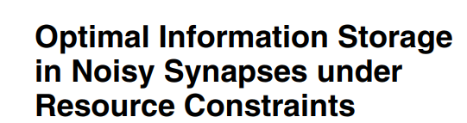

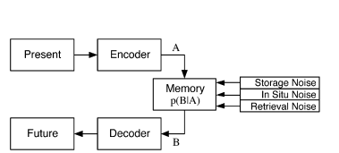
An application in neuroscience

Slide 19
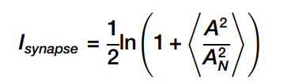


Information storage in biological synapses
According to Shannon’s theory, the quantity of information stored in a synapse is given by
The signal to noise ratio of a synapse is related to the volume occupied by the synapse
The quantity of information stored by unit of volume is given by

Slide 20
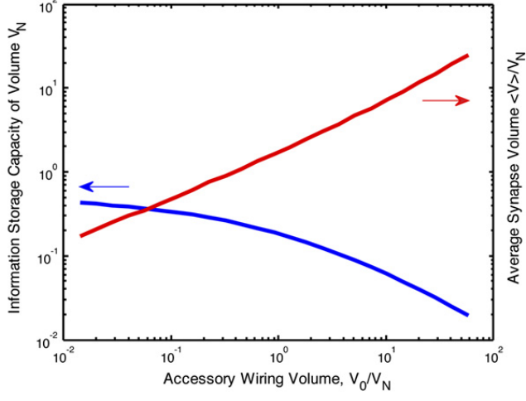
Maximizing the total quantity of information
Synapses require accessory volume
The maximal quantity of stored information dépend on the accessory volume.

Slide 21
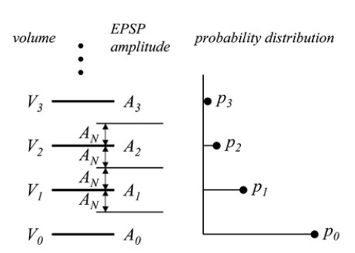
Optimal distribution of synaptic weigths
Discrete Synapses May Provide
Optimal Information Storage

